Slide 1
Statistical Flow Analysis
Chapter 5

Slide 2
Statistical Flow Analysis
Can serve a variety of purposes:
Identifying compromised hosts
Confirming or disproving data leakage
Individual profiling

Slide 3
Overview of Chapter 5
Process Overview
Sensors
Flow record Export Protocols
Collection and aggregation
Analysis

Slide 4
Process Overview
Definition: Flow Record
“A subset of information about a flow. Typically, a flow record includes the source and destination IP address, source and destination port (where applicable), protocol, date, time, and the amount of data transmitted in each flow.” (p160)
Processing System:
Sensor
Collector
Aggregator
Analysis
Notes:
Sensor – the device that is used to monitor the flows of traffic on any given segment and extract important bits of information to a flow record.
Collector – a server (or multiple servers) configured to listen on the network for flow record data and store it to a hard drive.
Aggregator – when multiple collectors are used, the data is typically aggregated on a central server for analysis.
Analysis – once the flow record data has been exported and stored, it can be analyzed using a wide variety of commercial, open-source, and homegrown tools.

Slide 5
Sensors (aka. Flow Sensors)
Sensor types
Network equipment
Standalone appliances
Sensor software
Argus
Softflowd
Yaf

Slide 6
Sensors (aka. Flow Sensors)
Sensor placement: factors to consider
Duplication
Time synchronization
Perimeter versus internal traffic
Resources
capacity
Modifying the environment: options available
Leverage existing equipment
Upgrade network equipment
Deploy additional sensors
Notes:
Modifying the environment refers to the investigative team and some of their options, if they deem it necessary to modify the network environment in order to collect, aggregate and analyze flow record data.

Slide 7
Flow Record Export Protocols
NetFlow
Caches flow information for the purposes of improving performance
IPFIX
“IP Flow Information Export”
sFlow
Used for statistical packet sampling and dows not support recording and processing information about every single packet.

Slide 8
Collection and Aggregation
Collector placement and architecture: factors to consider
Congestion
Security
Reliability
Capacity
Strategy for analysis
Collection Systems
SiLK
Flow-tools
Nfdump/NfSen
Argus

Slide 9
Analysis
Flow Record Analysis Techniques (typically an iterative process)
Goals and resources
Starting indicators
IP address of a compromised or malicious activity
Time frame in which malicious activity is suspected, even if the participants are unknown
Known ports on which a worm was suspected to be active
Specific flow records that indicate abnormal or unexplained activity
Analysis techniques
Filtering
Baselining
Dirty values
Activity pattern matching
Notes:
Filtering: as an investigator, one of your primary responsibilities is to reduce the amount of data you need to analyze. Filtering is the process for doing this. You might pick out subsets of flows for analysis until you have gathered the evidence you need and built your case.
Baselining: this is where you will be setting network baselines for traffic patterns, and putting together trends for the traffic going across a network.
Dirty Values: or “dirty words”, a list of keywords that can be used in searching for information in ASCII or Unicode strings. Dirty values are not usually “words” but could be suspicious IP addresses, ports, dates, and times. It is helpful to gather your list of dirty values as you move forward in your investigation.

Slide 10
Analysis
Activity pattern matching (basic elements of flow record analysis:
IP address
Ports
Protocol and flags
Directionality
Volume of data transferred
Notes:
IP address: great clues that reveal a lot about the cause and purpose of a flow. Consider where the IP address is: internal network, Internet-exposed, countries of origin, what companies they are registered to, and other factors.
Ports: not always tied to a service, traditionally they can be. They can also indicate whether a machine is port scanning or being scanned and help identify malicious activity.
Protocol and flags: layer 3 and 4 protocols are often tracked in flow record data. Can indicate completed connections, help identify connection attempts that were denied by firewalls, successful port scans, data transfers, and more. Can also help you make educated guesses as to the content and purpose of a flow.
Directionality: directionality of flows are crucial. Can indicate whether proprietary data has been leaked or a malicious program was downloaded. Can also help tell the difference between web-surfing and web-serving activities.
Volume of data transferred: can help indicate the type of activity and whether or not data transfer attempts were successful. For example, many small TCP packets may be indicative of port scanning, whereas large packets can indicate file exportation.

Slide 11
Analysis
Simple Patterns
Relating to IP addresses:
Many-to-one IP addresses
DDOS on the destination IP
Syslog server
“Drop box” data repository on the destination IP
Email server (at destination)
One-to-many IP addresses
Web server
Email server (at source)
SPAM bot
Warez server
Network port scanning
Many-to-many IP addresses
Peer-to-peer file sharing traffic
Widespread virus infection
One-to-one IP address
Targeted attack against a specific system
Routine server communications
Notes:
Context is key here. Need to know where the IP addresses are attached, internal, external, etc. If they are owned by your company, if so, do you know if they perform any of the mentioned functions?
Specific ports, protocols, timing information, and other elements can help to narrow down the meaning of the flow record data even further.

Slide 12
Analysis
Complex patterns:
Example: TCP SYN port scan might have the following characteristics
One source IP address
One or more destination IP addresses
Destination port numbers increasing incrementally
Volume of packets surpassing a specified value within a period of time
TCP protocol
Outbound protocol flags set to “SYN” (no full TCP connections)
Notes:
Fingerprinting is the process of matching complex flow record patterns to specific activities. When fingerprinting traffic, we examine multiple elements and their context and develop a hypothesis of the cause of the behavior.

Slide 13
Analysis (con’t) Tools
Flow record analysis tools
SiLK (a suite of flow export data analysis tools), some of these tools include:
Rwfilter: a core tool in the suite, designed to extract flows of interest, filter them by time and category, then partition them further by protocol attributes.
Rwstats, rwcount, rwcut, rwuniq, et al.: basic flow utilitites that work together to aggregate export data flows.
Rwidsquery: can take a Snort sensor rule and apply it to its own collected data, then write a rwfilter to produce the flows that match the rule or alert file.
Rwpmatch: libpcap-based program that reads in SiLK-formatted flow metadata and an input packter source and saves out jus the packets that match the flow metadata
Advanced SiLK
Notes:
See bullet list on p178
On the advanced SiLK, there is a python interpreter available that implements the SiLK functionality by exposing it through a python API. NetSA have provided a Tooltips wiki so the user community can share experiences…

Slide 14
Analysis (con’t) Tools
Flow-tools
Flow-report
Flow-nfilter
Flow-dscan
Argus client tools
Ra – basic tool for reading, filtering, and printing Argus data
Racluster – cluster flow export data based on user-specified criteria.
Rasort – sort flow data based on user-specified criteria, such as source or destination IP, time, TTL, flow duration, and more.
Ragrep – powerful regular expression and pattern matching, based on the GNU “grep” utility
Rahisto – generate frequency distribution tables for user-selected metrics such as flow record duration, source and destinatino port number, bytes transferred, packet count, bits per second, and more.
Ragraph – create visual plots based on user-specified fields of interest, such as bytes, packet counts, average duration, IP, ports, and more.

Slide 15
Analysis (con’t) Tools
FlowTraq (commercial)
Nfdump/NfSen (Netflow Sensor) features include:
Aggregate flow record fields by specific fields
Limit by time range
Generate statistics about IP addresses, interfaces, ports, and more
Anonymize IP addresses
Customize output format
FPF-style filters

Slide 16
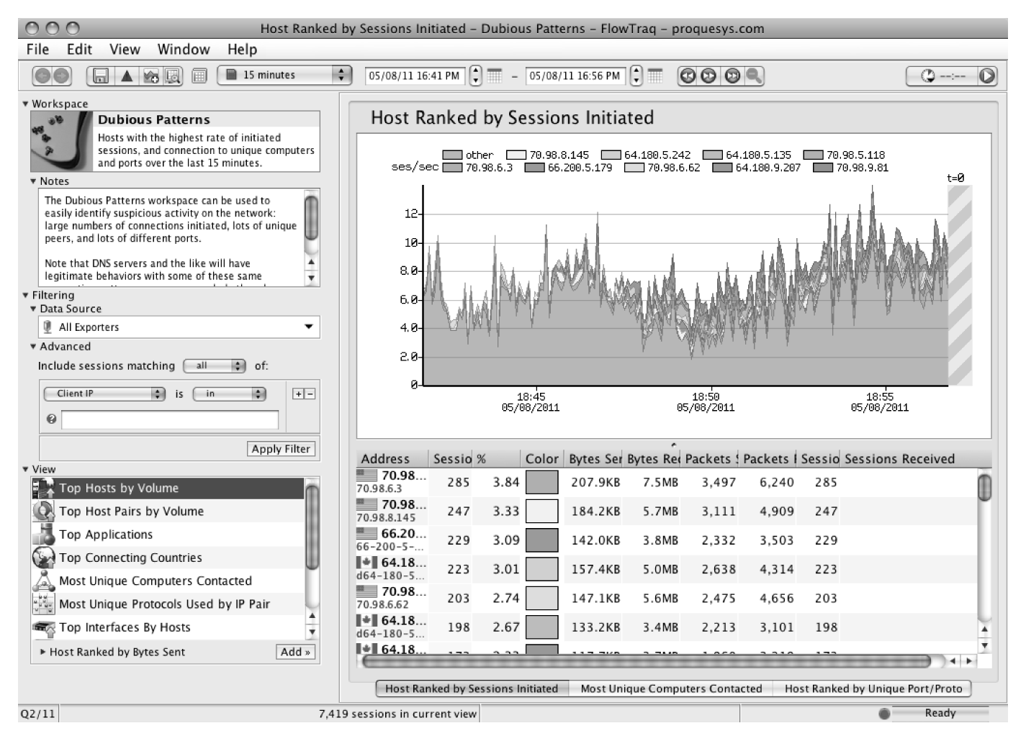
From Network Forensics, by Sherri Davidoff and Jonathan Ham (ISBN: 978-0-13-256471-7) Copyright © 2012 Pearson Education, Inc. All rights reserved.
Figure 5.1 A screenshot of the Flow Traq commercial flow record analysis GUI, created using ProQueSys’ online demo.

Slide 17
Analysis (con’t) Tools
EtherApe
Libpcap-based graphical tool that visually displays network activity in real time.

Slide 18
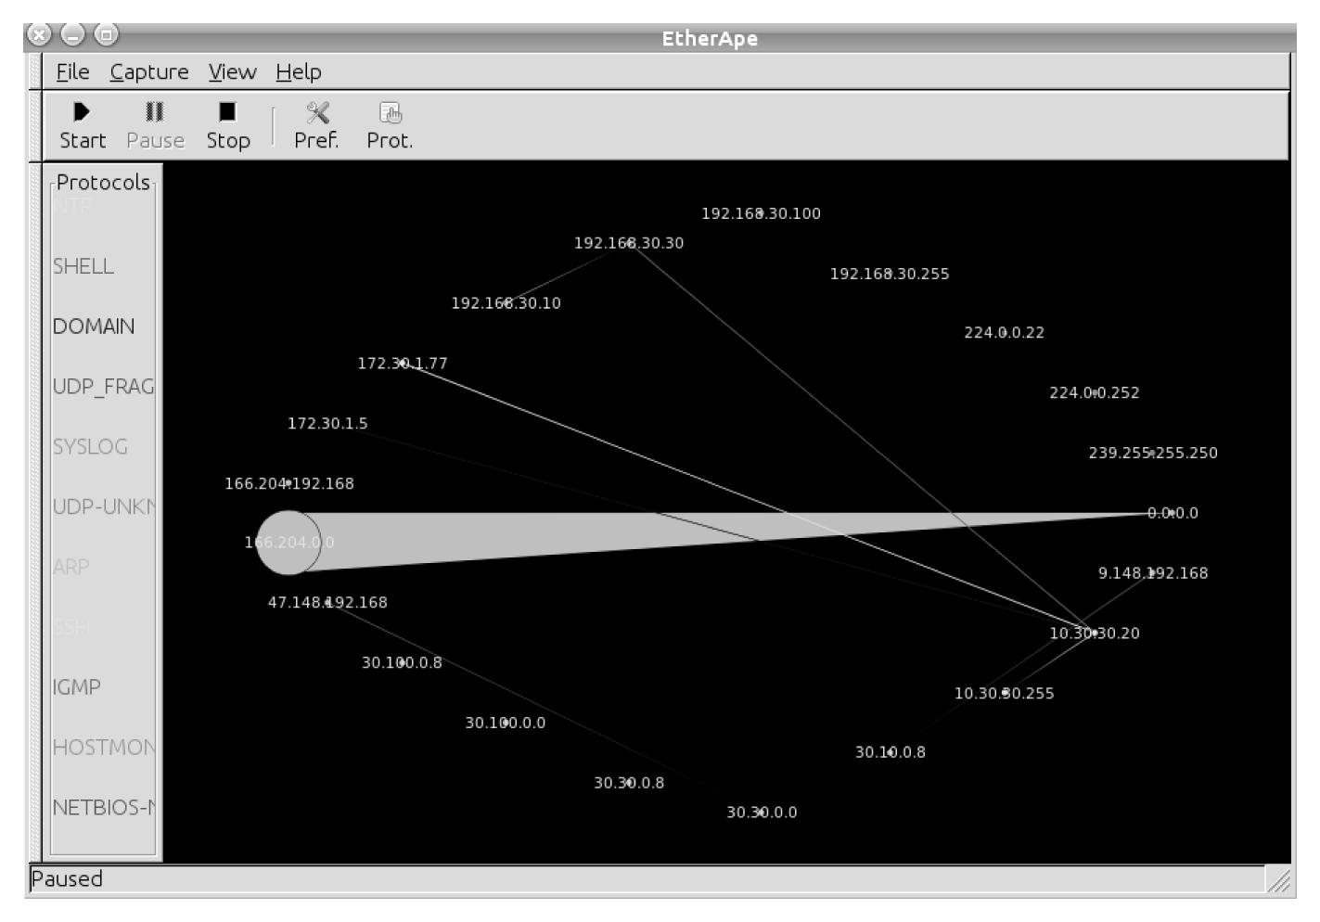
From Network Forensics, by Sherri Davidoff and Jonathan Ham (ISBN: 978-0-13-256471-7) Copyright © 2012 Pearson Education, Inc. All rights reserved.
Figure 5.2 The main EtherApe screen.

Slide 19
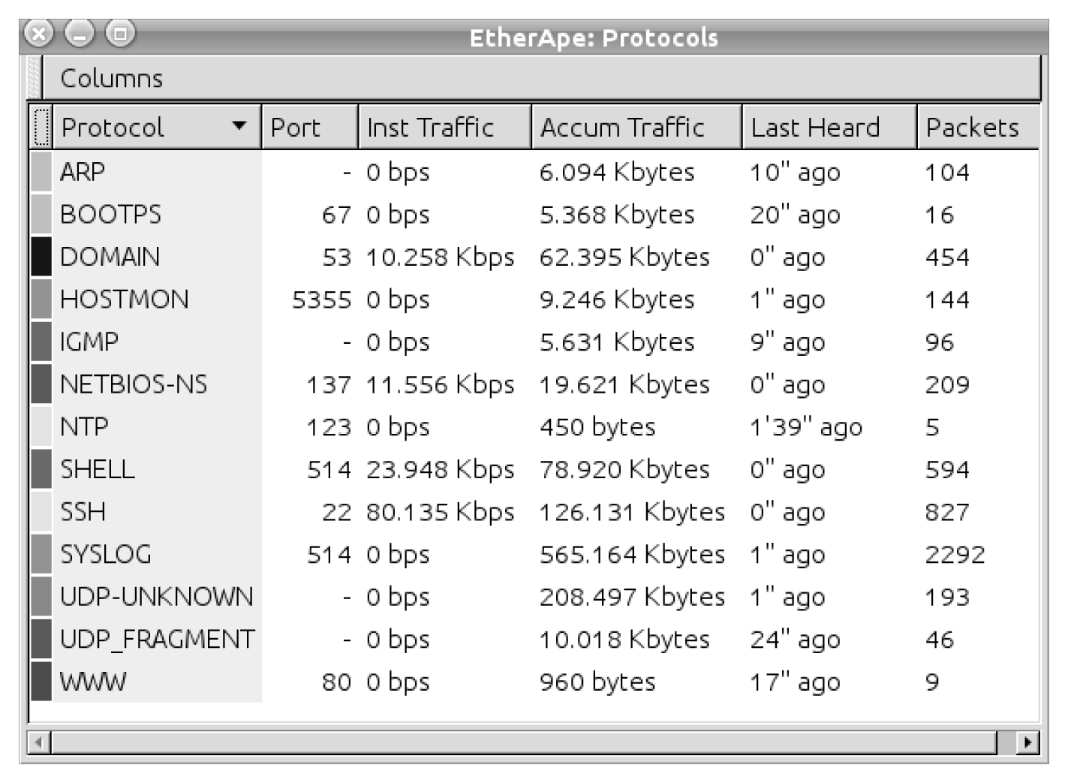
From Network Forensics, by Sherri Davidoff and Jonathan Ham (ISBN: 978-0-13-256471-7) Copyright © 2012 Pearson Education, Inc. All rights reserved.
Figure 5.3 The EtherApe “Protocols” window.

Slide 20
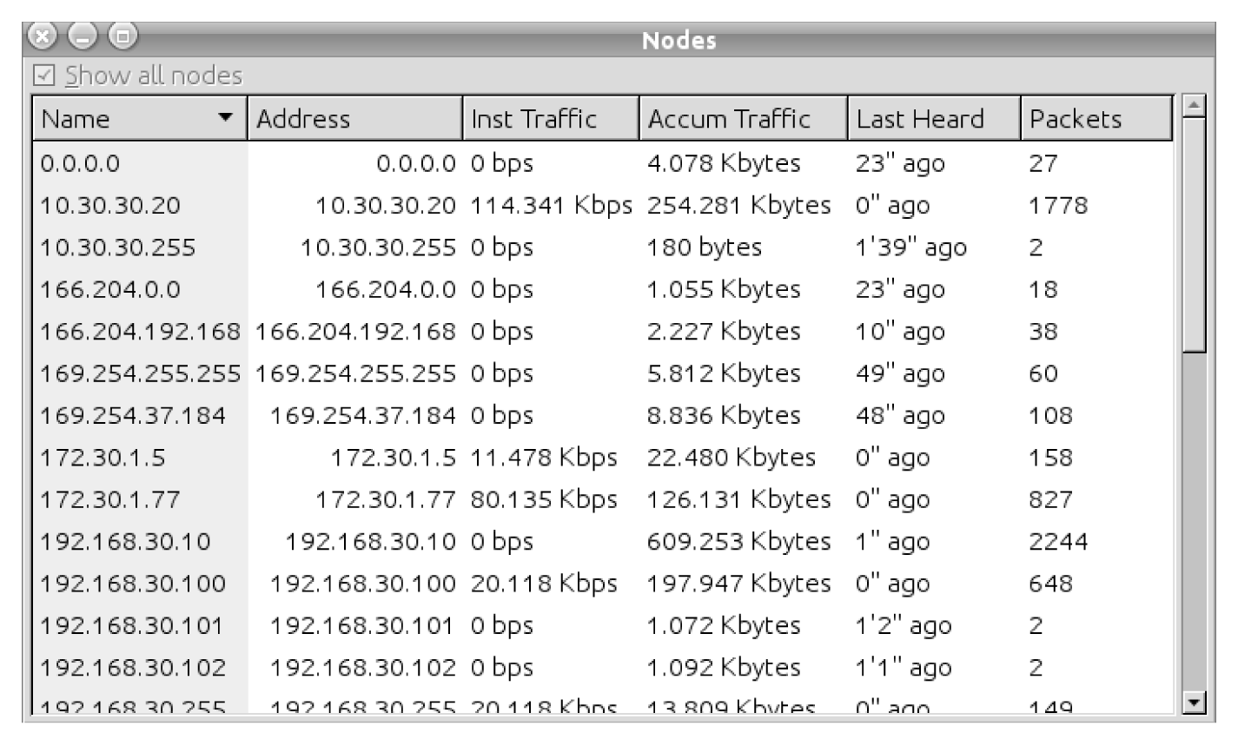
From Network Forensics, by Sherri Davidoff and Jonathan Ham (ISBN: 978-0-13-256471-7) Copyright © 2012 Pearson Education, Inc. All rights reserved.
Figure 5.4 The EtherApe “Nodes” window.

